Slide 1
Programming Practice Solutions Review

Slide 2
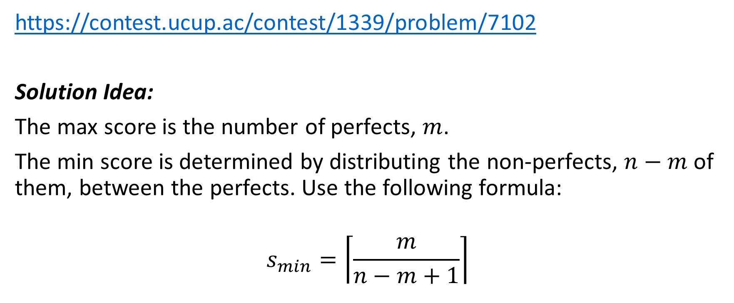
Live Love
https://contest.ucup.ac/contest/1339/problem/7102
Solution Idea:
The max score is the number of perfects, $m$.
The min score is determined by distributing the non-perfects, $n−m$ of them, between the perfects. Use the following formula:
$$s_{min}=\left\lceil \frac{m}{n−m+1}\right\rceil$$

Slide 3
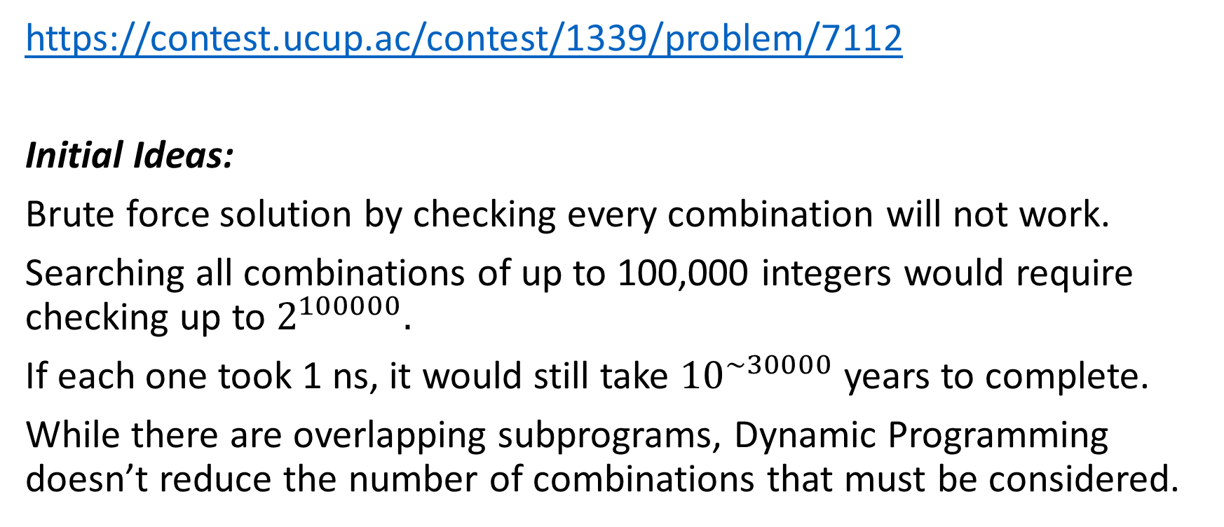
XOR Clique
https://contest.ucup.ac/contest/1339/problem/7112
Initial Ideas:
Brute force solution by checking every combination will not work.
Searching all combinations of up to 100,000 integers would require checking up to $2^{100000}.$
If each one took 1 ns, it would still take ${10}^{\sim 30000}$ years to complete.
While there are overlapping subprograms, Dynamic Programming doesn’t reduce the number of combinations that must be considered.

Slide 4
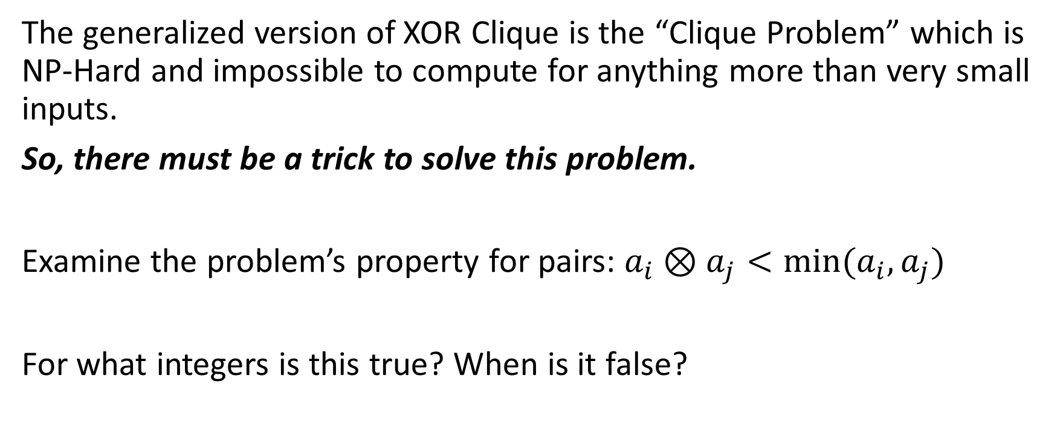
XOR Clique – The Trick
The generalized version of XOR Clique is the “Clique Problem” which is NP-Hard and impossible to compute for anything more than very small inputs.
So, there must be a trick to solve this problem.
Examine the problem’s property for pairs: $a_{i}⊗a_{j}<min⁡(a_{i},a_{j})$
For what integers is this true? When is it false?

Slide 5
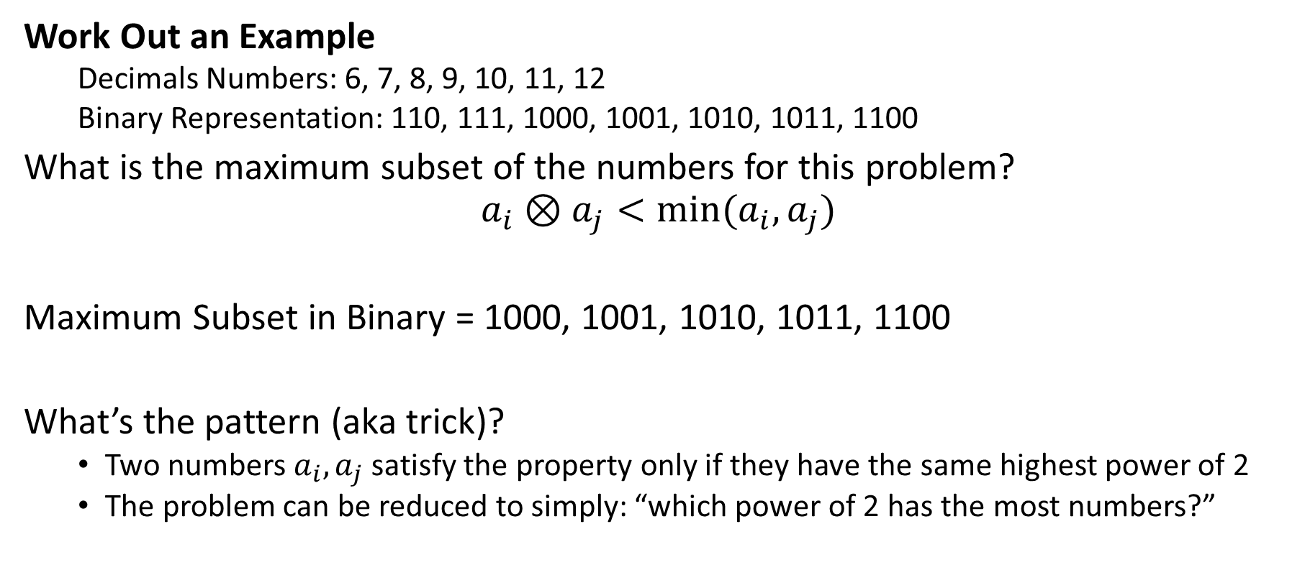
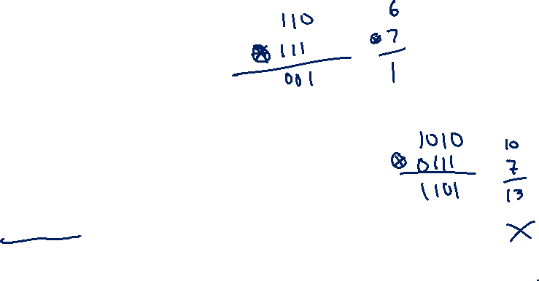
XOR Clique – Binary XOR
Work Out an Example
Decimals Numbers: 6, 7, 8, 9, 10, 11, 12
Binary Representation: 110, 111, 1000, 1001, 1010, 1011, 1100
What is the maximum subset of the numbers for this problem?
$$a_{i}⊗a_{j}<min⁡(a_{i},a_{j})$$
Maximum Subset in Binary = 1000, 1001, 1010, 1011, 1100
What’s the pattern (aka trick)?
Two numbers $a_{i}, a_{j}$ satisfy the property only if they have the same highest power of 2
The problem can be reduced to simply: “which power of 2 has the most numbers?”

Slide 6
XOR Clique – Solution Idea
For each power of 2, count how many numbers in the set have that as their highest power of 2.
Output the maximum count.
Example:
6, 7, 8, 9, 10, 11, 12, 15, 18, 26, 28, 29, 31, 33, 36
Output = 6

Slide 7
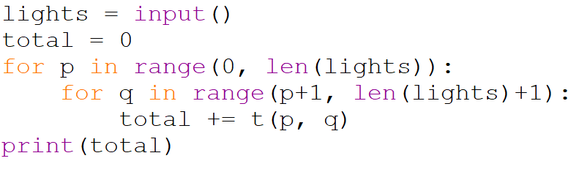
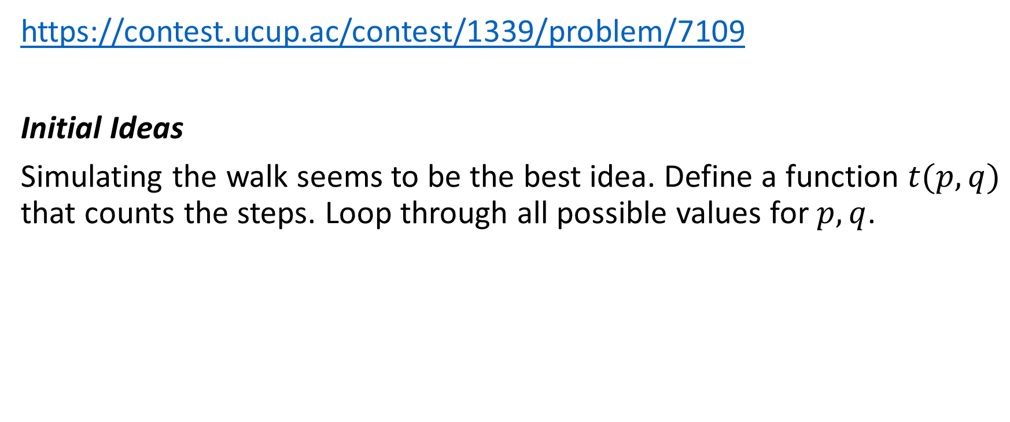
Traveling on the Axis
https://contest.ucup.ac/contest/1339/problem/7109
Initial Ideas
Simulating the walk seems to be the best idea. Define a function $t(p,q)$ that counts the steps. Loop through all possible values for $p,q$.

Slide 8
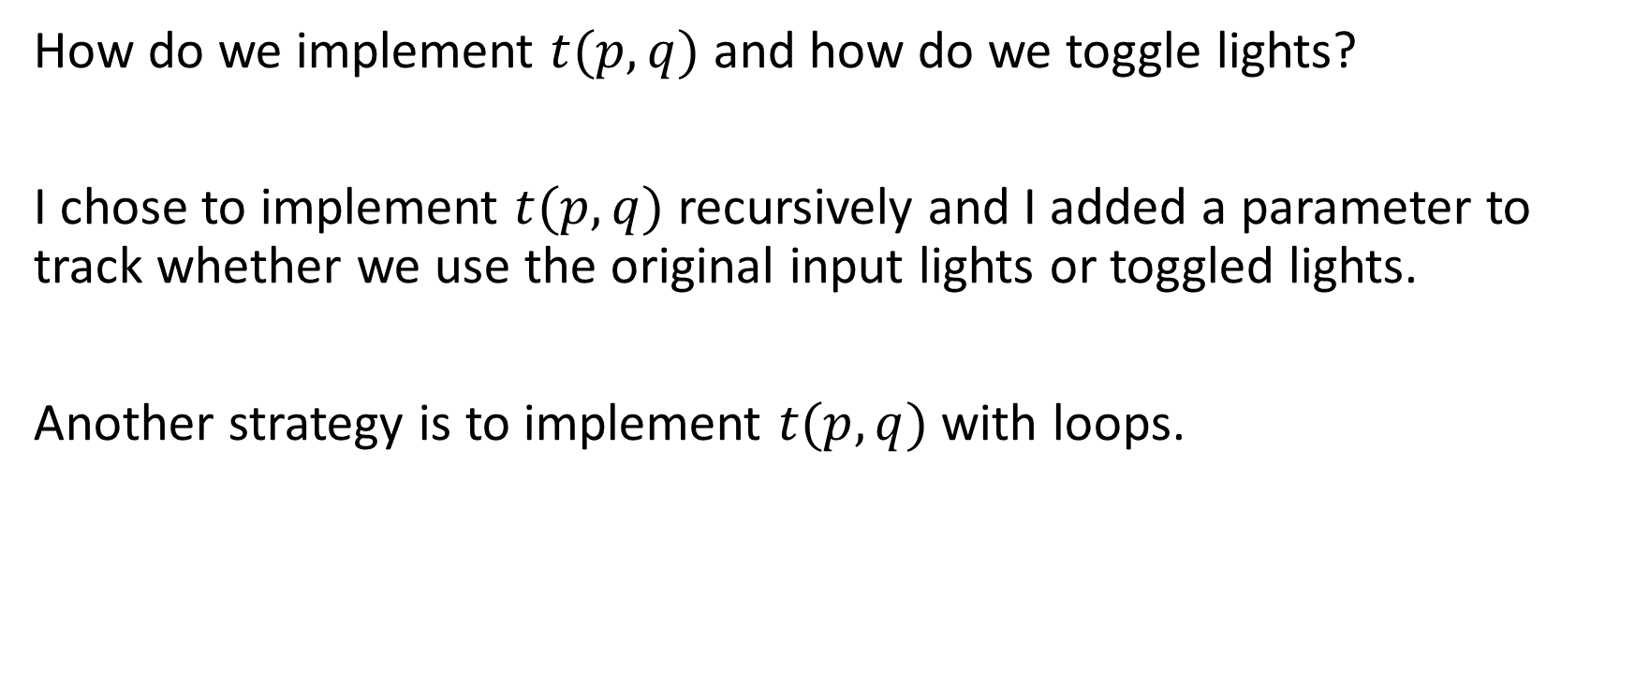
Implementation Challenges
How do we implement $t(p,q)$ and how do we toggle lights?
I chose to implement $t(p,q)$ recursively and I added a parameter to track whether we use the original input lights or toggled lights.
Another strategy is to implement $t(p,q)$ with loops.

Slide 9
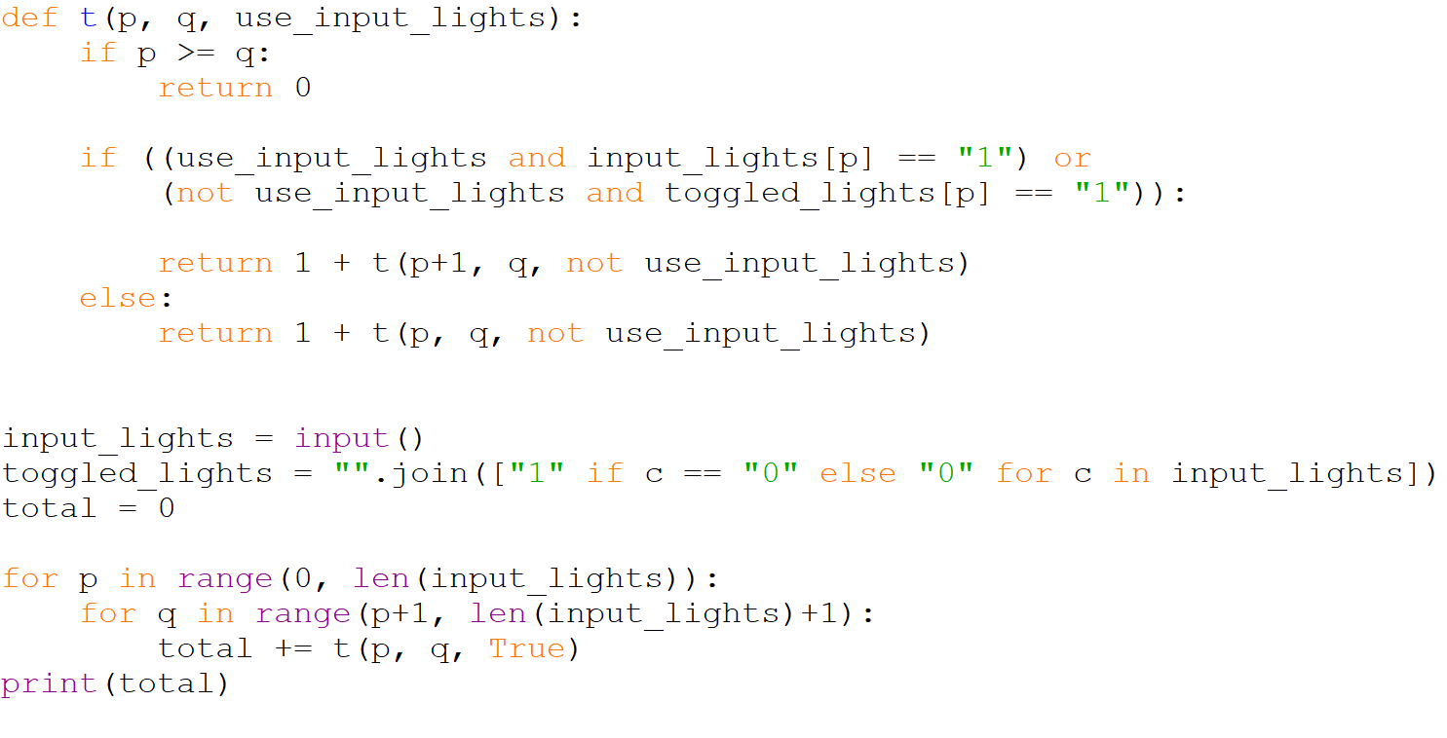

Slide 10
We’ve got issues…
The input could have up to 100000 lights (100000 1’s or 0’s).
Default recursion depth limit for Python is 1000…
The solution is too slow… partly because it solving the same problem many times. We need dynamic programming.

Slide 11
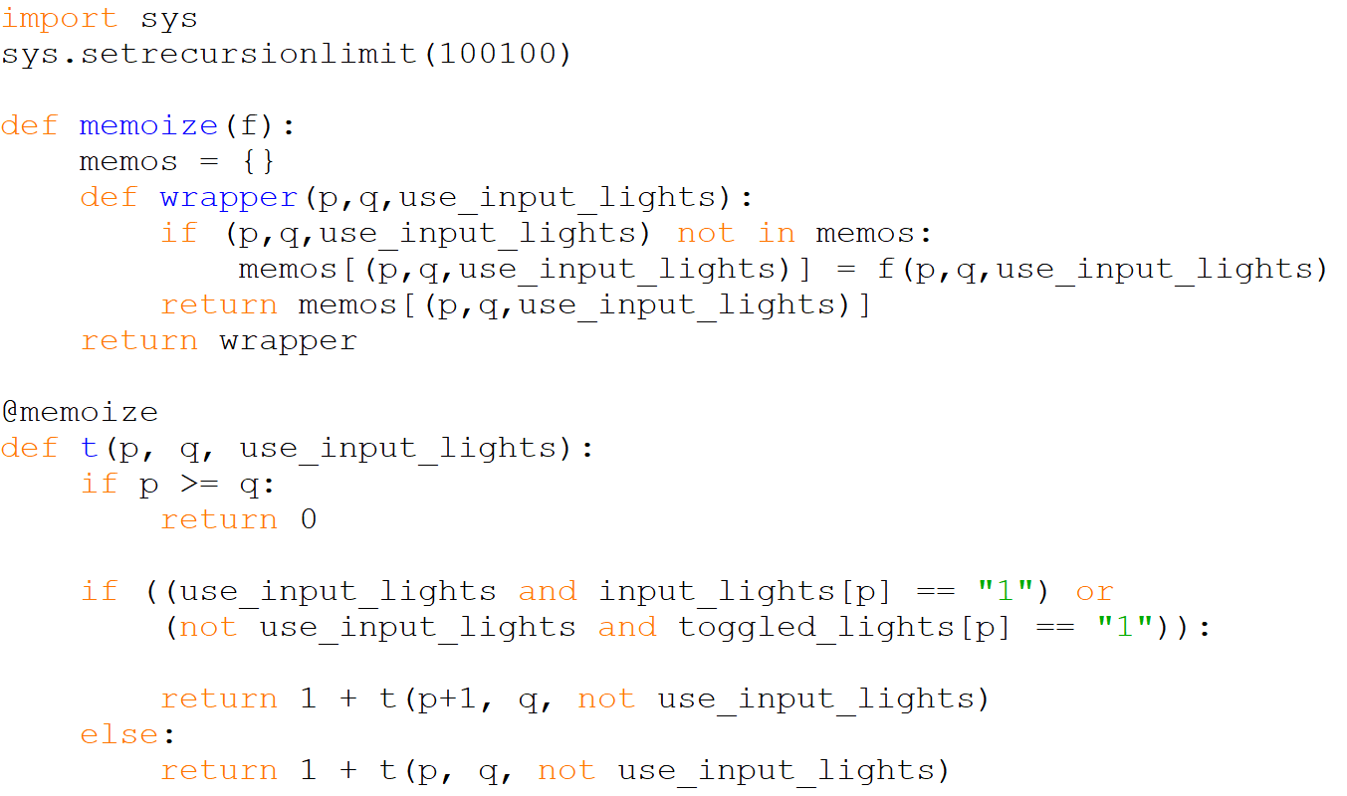

Slide 12
Recursive Solution Isn’t Great
For large inputs, it’s possible this recursive solution with memoization is too slow and/or uses too much memory. A tabulation approach with loops is probably best.
A loop-based “tabulation” approach to this dynamic programming problem is possible the only solution that would get accepted.
Unfortunately, I don’t have as much skill/experience with tabulation and haven’t figure it out yet.

Slide 13
Dynamic Programming Basics
Oftentimes in programming problems, subproblems overlap. If we solve the subproblems multiple times, our programs are too slow.
Memoization is a dynamic programming technique where we keep track of memos, i.e. solutions to subproblems, so that we don’t resolve the same problem twice. Memoization is “top-down” and recursive. It works well if the recursion depth is not too large.
Tabulation is a dynamic programming technique where we solve the smaller subproblems first and build them up to the full problem. Tabulation is “bottom-up” and not recursive. Some problems are more difficult to solve with tabulation.

Slide 14
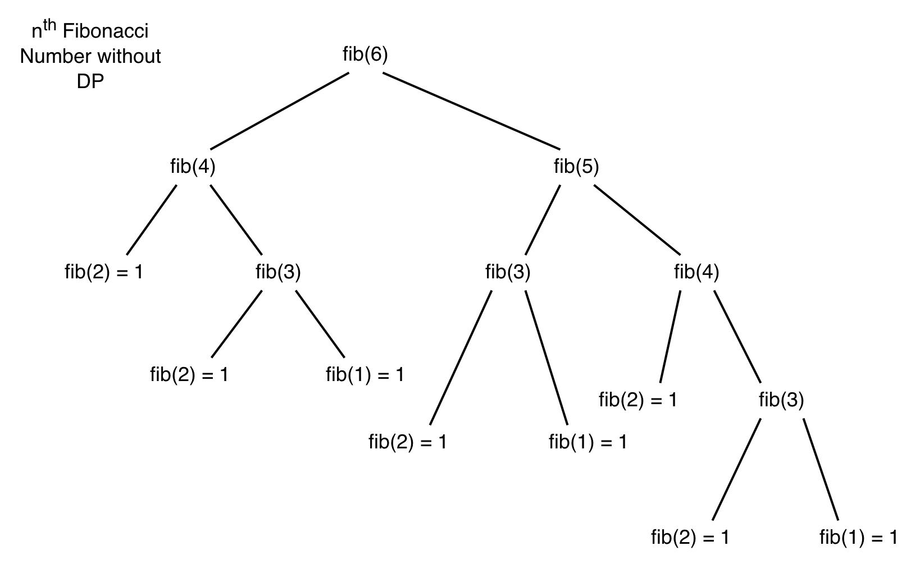

Slide 15
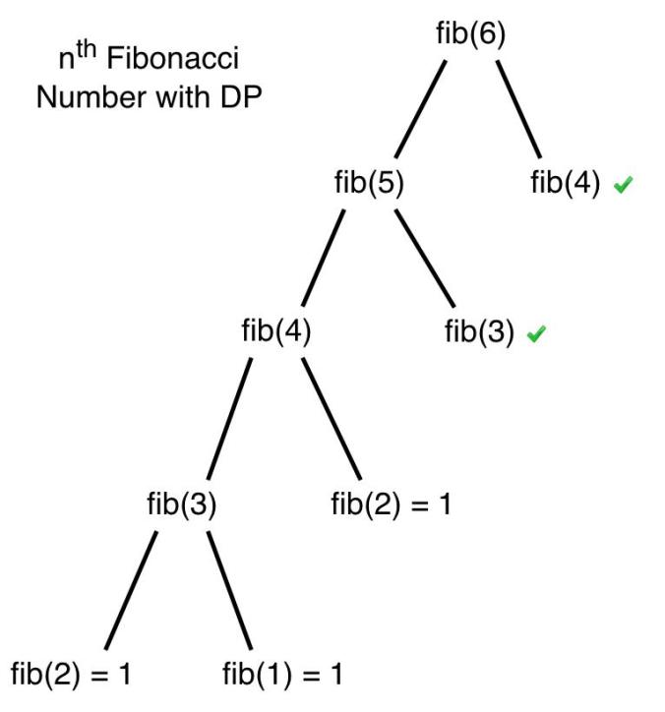

Slide 16
Takeaways
For non-trivial problems, working out examples is almost always your best strategy to get started.
Before you implement Brute Force approaches, analyze the computational complexity and consider if dynamic programming works.
Brute Force solutions will always work for the simple example inputs/outputs but that doesn’t mean you solved the problem

